Slide 1
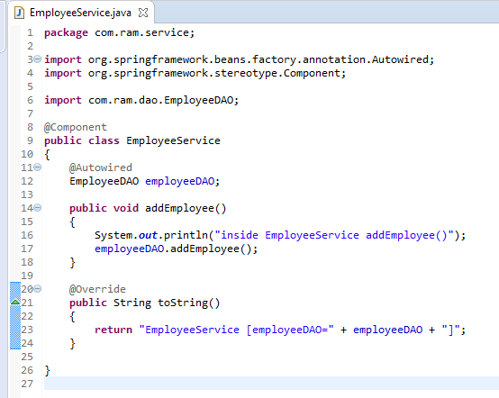
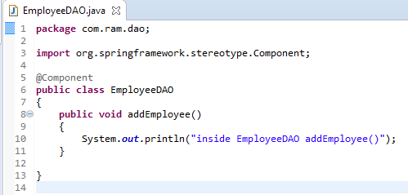
Auto Components Scanning
Annotate with @Component to indicate this class is an auto scan component.

Slide 2
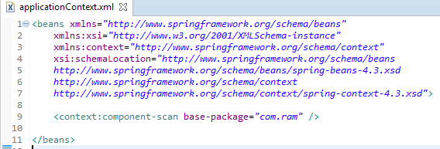
Auto Components Scanning
Add this “context:component” in bean configuration file, it means, enable auto scanning feature in Spring.
The base-package is indicate where are your components stored, Spring will scan this folder and create the bean (annotated with @Component) and register it in Spring container.

Slide 3
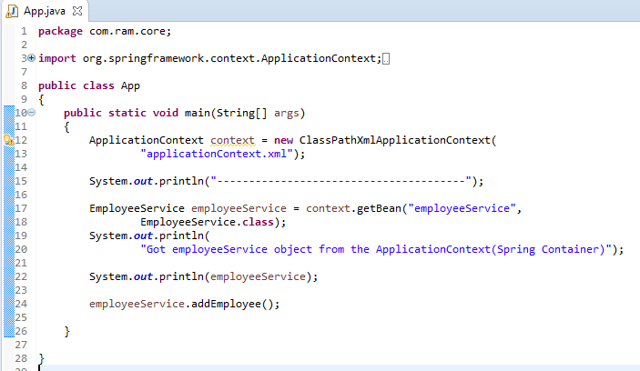
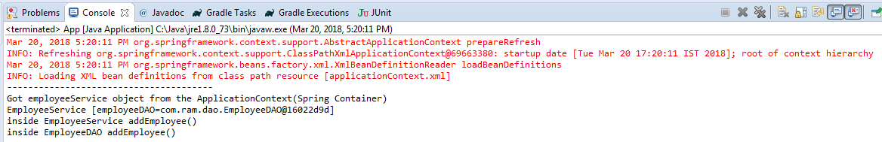
Auto Components Scanning

